Slide 1
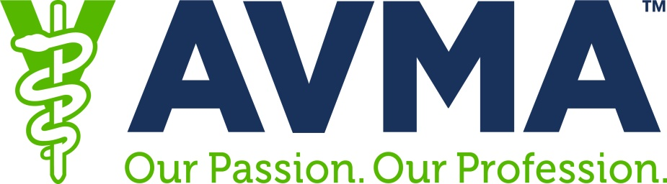

The Fight for Financial Aid
Assisting Veterinary Students &
Early Career Veterinarians
AVMA & AAVMC priorities for the Higher Education Reauthorization
Kevin Cain, Director of Governmental Affairs, AAVMC
202-371-9195, ext. 117, KCain@AAVMC.org
Gina Luke, Assistant Director, Governmental Relations Division, AVMA
202-289-3204, GLuke@AVMA.org
Notes:
Kevin and Gina will briefly introduce themselves and their respective organizations.

Slide 2
Together we can FIX THE DEBT
2015 Debt to Income 2.1:1 to 1.4:1
$70,000 = average starting salary in 2015
142,294 = Mean Ed Debt for Class of 2015
$300,000 = 5% of 2015 grads ed debt
71.6% = tuition & fees, books and materials
23.5% = living expenses & transportation
Notes:
The AVMA and AAVMC are responding to the calls of aspiring veterinarians and early career veterinarians who have expressed their concerns about increasing educational indebtedness, escalating costs of higher education and earning a veterinary degree, the terms and conditions for borrowing federal student loans, managing repayment. We’re working with stakeholder partners to reduce the debt-to-income ratio from 2.1:1 to 1.4:1. To achieve this goal we’re co-leading the Fix the Debt (FTD) initiative. Among our goals is lead a successful national advocacy campaign advancing our priorities that will improve to the federal student financial aid program. We invite veterinary students and early career veterinarians to get involved in the fight for financial aid. Together we’ll push federal lawmakers to alleviate the debt burden felt by veterinarians. We’ll urge congress to pass a Higher Education Act that makes the federal student aid system better serve the needs of all veterinary students.
The AVMA annual senior survey of veterinary students in 2015 found that 89 percent of the 3,018 U.S. veterinary college graduates accumulated debt. The mean debt accumulated for all students over four years was $142,394; five percent of these students graduated with more than $300,000 debt. The majority of debt incurred by veterinary students is attributed to the cost of tuition and fees (68.3 percent) was attributed to tuition and fees, followed by living expenses (19.5 percent), transportation (4.4 percent), books and materials (3.3 percent), veterinary equipment (2 percent) and all other expenses (2.5 percent)i.
New veterinarians can expect an average starting salary of approximately $70,000 for a fulltime position, making the current debt-to-income ratio 2:1. AVMA is working with stakeholder partners to reduce the debt-to-income ratio to 1.4:1. To achieve this goal, AVMA is leading the multifaceted Fix the Debt (FTD) initiative alongside the Association of American Veterinary Medical Colleges (AAVMC). One of our goals is to lead a successful national advocacy campaign that will advance our priorities to improve the federal student financial aid program. We invite veterinary students, early career veterinarians and others to join AVMA’s Congressional Advocacy Network. Together we will urge lawmakers to take steps that alleviate the debt burden felt by veterinarians by passing bills to make the federal student aid system better serve the needs of all veterinary students by

Slide 3
Note: Dentistry was adjusted to remove the average undergraduate debt of $30,100 according to
The Institute of College Access and Success Student Debt and the Class of 2015, 11th Annual Report.
Notes:
AVMA and AAVMC will not be in the trenches alone. We will be joined by associations representing other health professions and their respective student members. All told the health professions are a small percentage of the total numbers of students although we account for a good amount of borrowing in federal student loans.
2015 first-year students: 7,219 osteopathic medicine; 20,343 allopathic medicine students; 5,943 dental students; 63,460 pharmacy students; 3,000 veterinary.
AVMA’s senior survey found that 89% of 2015 graduates’ had educational debt. The mean debt over four years was $142,394 with 5% percent of students graduating with more than $300,000 in debt.
Total educational debt for 2015 graduates from the U.S. CVMs was est. at $427,502,116.
Total tuition and fees est. $382,559,375
Est. living expenses: $240,623,655
Total est. cost to $623,183,030 for all of the 3,018 U.S. CVM graduates in 2015.
The interest expense for borrowing these funds adds another $81,924,168,
Grant total cost of the veterinary education to $705,107,198.
Because students applied various outside sources of funds to pay for some or all of these expenses and thus total debt was just 61 percent of this total cost.

Slide 4
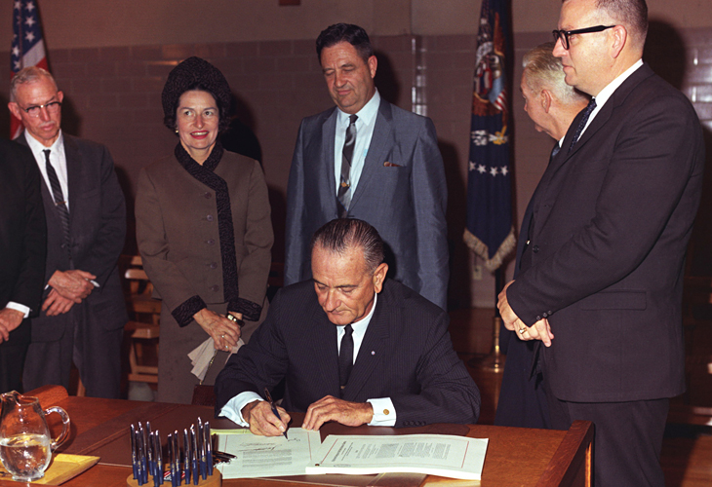
Higher Education Act Reauthorization
HEA signed by LBJ Nov. 8, 1965
Current HEA expired in 2013
Sweeping federal law that
includes the entire federal
student loan system, Pell
Grants, teacher-preparation
provisions, and various programs that help disadvantaged students access higher education.
Notes:
The last president to sign a HEA bill was George W. Bush on Aug. 2008. That bill (H.R. 4137) was 1,158 pages long. It took 5 years and 14 extensions but was to set federal higher-education policy for five years -- through 2013. Well the bill has still not been reauthorized.
Regardless, lawmakers sitting on the Senate Health, Education, Labor and Pensions Committee and the House Education and the Workforce Committee will examine ways to strengthen and enhance federal student financial aid programs, and they may eliminate or create new programs. Finding ways to encourage more responsible borrowing and increasing financial literacy will certainly be a focus. Congress will also examine ways to reign in college costs, scrutinize accountability measures and determine whether regulations are appropriate or overly burdensome.

Slide 5
115th Congress runs two years (Jan. ‘17 – Dec. ‘18)
First session has a congested legislative calendar
  Senate in session for 182 days (in Washington)
  House is session 145 days (in Washington)
  Overlap scheduled just 139 days
First 6 months:
  Confirmation hearings & Supreme Court nominee
  Budget and appropriations matters
  Health care fight
  Reform the tax code
Notes:
No matter how ambitious the Trump Administration is or what it hopes to achieve over the course of the next four years, and no matter when and who comprises the Trump team, they must work with Congress to pass legislation.
Each congress runs for a two-year cycle. You can see the number of days each chamber will be working in DC and how few days they overlap – just 139. Because these first few months have not been particularly productive and there is so little overlap given the ambitious agenda that is (or was) set, it looks increasingly clear that the reauthorization of the Higher Education Act – which congress was supposed to have passed in 2013 – will again be denied the necessary time and attention needed on the congressional calendar to pass the bill in 2017.
Regardless of the tight congressional calendar work has already begun to reauthorize the Higher Education Act with the House Education and the Workforce holding its first hearing of the year on simplifying student financial aid. In addition, lawmakers will introduce legislation throughout the 115th Congress dealing with some aspect of higher education are continually introduced in congress so it is imperative that veterinarians and aspiring veterinarians become engaged in the fight to save financial aid for current and future students.

Slide 6
Federal Student Aid
$140-B annually in aid (Stafford,
Perkins, GradPLUS, Pell, etc.)
2016, $1.3-T portfolio
covering 41+ million borrowers
In 2016, 1 in 4 borrowers in
default or struggling to
repay their loans.
Notes:
A boatload of federal aid money is available each year to help students pay for college. About 12 million students borrow $112-B in new Direct Loans combined with about $28B in Consolidation Loans. This accounts for 77% of all student aid available from ED (other aid available is Pell Grants, work-study and other programs).
All told, in 2016 the federal government student loan portfolio covered 41+ million loan borrowers and totaled $1.3 trillion. This is an enormous sum to finance college but it is an investment in people and their dreams of becoming teachers and engineers, nurses and pharmacists, lawyers and archeologists, as well as doctors and veterinarians.
Of course the grand total is eye popping; however, what has captured the attention of lawmakers is the alarming fact that 1 in 4 student loan borrowers is in default or struggling to repay their student loans. Lawmakers are examining the terms offered on student loans and the repayment options available to borrowers. They are also looking at what improvements are needed to strengthen financial literacy of borrowers.

Slide 7
Primary Federal Student Loans
Direct Stafford Sub Loans and Unsub
undergrads may borrow at 3.76%. Interest cap: 8.25%
Direct Stafford Unsub Loans for grad-prof
Graduate & Professional student may borrow at 5.31%.
Interest cap: 9.5%. Annual: $47,167; Aggregate: $234,000
Direct GradPLUS 6.31% capped at 10.5%, max loan amount is COA (determined by the school) - other financial aid
Federal Perkins (5% fixed)
Origination fees (range 1.073% - 4.292%)
Notes:
The federal government, through the U.S. Department of Education, offers eligible students at participating schools Direct Subsidized Loans and Direct Unsubsidized Loans (sometimes these loans as Stafford Loans or Direct Stafford Loans; Direct PLUS Loans (for graduate and professional students or parents); and Federal Perkins Loans. For Loans borrowed between July 1, 2016-July 1, 2017 have fixed interest rates as follows:
Direct Subsidized Loans for undergraduate students have an interest rate of 3.76% (caped at 8.25%)
Direct Unsubsidized Loans for undergraduate students have interest rate of 3.76% (capped at 8.25%)
Direct Unsubsidized Loans for grad-professional students with interest rate is 5.31% (capped at 9.5%)
GradPLUS Loans have flexible loan limits. A borrower cannot have an adverse credit history. A 4.272% fee is deducted from the loan amount before the funds are sent to the school. The interest rate of 6.31% (capped at 10.5%)
Federal Perkins Loans have a fixed interest rate of 5%
Your CVM determines the loan type and the actual loan amount you are eligible to receive each academic year. However, there are annual and aggregate loan limits. The annual loan cap for veterinary students is $47,167; while the aggregate is $234,000.
Borrowers are charged a loan origination fee ranging from 1.073% to 4.292% each time they borrow a loan. These fees are deducted upfront from student loans before the funds are disbursed to a CVM.
After you graduate, leave school, or drop below half-time enrollment, you will have a 6-month grace period before you are required to begin repayment. During this period, you'll receive repayment information from your loan servicer, and you'll be notified of your first payment due date. Payments are usually due monthly.

Slide 8
Standard & Income Driven Repayment Plans
Standard Plan (automatically enrolled in 10 years/120 monthly payments)
Revised Pay As You Earn Plan (REPAY)
  any borrower with federal student loans
  Undergrads: 10% of discretionary income for 20 years
  Grads: 12% of discretionary income for 25 years
  Married borrowers must use collective AGI
Income Contingent
  any borrower with federal student loans
  20% of discretionary income for 25 years
Pay As You Earn (PAYE) Plan – must qualify
  10% of discretionary income for 20 years
Income-based Repayment (IBR) Plan – must qualify
    Borrowers on/after 7/1/14: 10% of discretionary income for 20 years
    Borrowers before 7/1/2014: 15% of discretionary income for 25 years
Notes:
Federal student loan borrowers are automatically enrolled in the standard 10-year plan (120 monthly payments). To lower the monthly payment and extend the time to repay up to 25 years, a borrower must sign up for IDR. A borrower qualifies if their federal student loan debt is higher than their discretionary income or represents a significant portion of their annual income. Whether a borrower has remaining debt forgiven at the end of the repayment period depends on: 1) how quickly their income rises and 2) their debt to income ratio – how large their income is relative to their debt. Because of these factors, a borrower may fully repay their loan before the end of the repayment period. In addition, under current IRS rules, a borrower will be required to pay income tax on any amount that’s forgiven if they still have a remaining balance at the end of the repayment period. Keep in mind that whenever one makes lower payments or extends the repayment period, a borrower will likely pay more in interest over time—sometimes significantly more. Also, borrowers also ought to know that for any IDR plan, periods of economic hardship, deferment and periods of repayment under certain other repayment plans, will count toward the total repayment period.
Current Income-Driven Repayment Plans
Revised Pay As You Earn Plan/REPAYE Plan - Generally 10% of your discretionary income. Repayment period is 20 years if all loans you’re repaying under the plan were received for undergraduate study and 25 years if any loans you’re repaying under the plan were received for graduate or professional study. AVMA is troubled by some features of the revised plan: 1) if a borrower received any loans as a professional student, the repayment period is 25 years instead of 20 for undergraduates; 2) for married borrowers filing jointly or separately, the AGI of both the borrower and the spouse are used to calculate the monthly payment amount; and 3) there is no cap on the monthly payment.
For PAYE and IBR a borrower must meet eligibility requirements to qualify. The payment you’d be required to make under the PAYE or IBR plan (based on your income and family size) must be less than what you would pay under the Standard Repayment Plan with a 10-year repayment period.
Pay and You Earn (PAYE) - Generally 10% of your discretionary income, but never more than the 10-year Standard Repayment Plan amount. Repayment period is 20 years.
Income-based Repayment (IBR) - Generally 10% of your discretionary income if you're a new borrower on or after 7/1/14, but never more than the 10-year Standard Repayment Plan amount. Generally 15% of your discretionary income if you're not a new borrower on or after 7/1/14, but never more than the 10-year Standard Repayment Plan amount. Repayment period is 20 years if you’re a new borrower on or after 7/1/14. And 25 years if you’re not a new borrower on or after 7/1/14.
ICR Plan – Payments based on the lesser of the following: 20% of your discretionary income or what you would pay on a repayment plan with a fixed payment over the course of 12 years, adjusted according to your income. Repayment period is 25 years. If you’re making payments under an IDR plan and also working toward loan forgiveness under the PSLF, you may qualify for forgiveness of any remaining loan balance after you've made 10 years of qualifying payments, instead of 20 or 25 years. Qualifying payments for the PSLF Program include payments made under any of the income-driven repayment plans.
Potential new Trump plan: He claims he wants to modify IBR capping income used for loan repayment at 12.5% (compared to the current 10% currently), but allowing for forgiveness after 15 years of repayment instead of 20 years of repayment. If adopted, the Trump IBR plan would be more generous to borrowers, especially those who have large loan balances like veterinary students.

Slide 9
Consolidation
Federal Direct Consolidation Loan: Combines all federal student loans into one new loan. Provides borrower 1 payment and up to 30 years to repay. There is no fee.
Private Lender Consolidation Loan: requirements vary from one lender to the next. Generally combines all federal and private student loans into one new loan. Refinancing option to lower interest rate based on creditworthiness. Borrowers lose all federal loan benefits.
Notes:
Federal Direct Consolidation Loan permits a borrower (who has graduated, left school, or dropped below half-time enrollment) with a federal loan made by the U.S. Department of Education to combine one or more federal student loans into one new loan. The loans consolidated must be in repayment or grace. A Direct Consolidation Loan has a fixed interest rate for the life of the loan. The fixed rate is based on the weighted average of the interest rates on the loans being consolidated, rounded up to the nearest one-eighth of 1%. There is no cap on the interest rate of a Direct Consolidation Loan. As a result of consolidation, the borrower can make only one monthly payment on their federal loans, and the amount of time they have to repay can be from 10 to 30 years. A borrower choosing this option will lose any borrower benefits offered with the original loans. Borrower benefits from your original loan, which may include interest rate discounts, principal rebates, or some loan cancellation benefits. A borrower interested in a Direct Consolidation Loan may apply through StudentLoans.gov. This process offers both electronic and paper options. Also, a borrower may ask questions about consolidating loans before they apply by contacting the Loan Consolidation Information Call Center at 1-800-557-7392. Federal refinancing is not presently available.
Private bank Consolidation Loan: Based on a borrower’s creditworthiness, a private lender may consolidate both private and federal loans (note you cannot roll private and federal loans into one new federal Direct Consolidation Loan). The ability to qualify for private bank consolidation varies from one lender to the next. A benefit of private consolidation is the ability to refinance and potentially secure a lower interest rate but that is based on your creditworthiness. When you do a private consolidation, you may not want to refinance any federal loans because you’ll lose your eligibility for government-backed repayment plans. But if you don’t plan to use those programs and can financially benefit by refinancing to a lower interest rate, this may be a viable option for you.

Slide 10
Delaying Payment
Grace Period: for 6 months following graduation
Deferment: postpones payment for limited time
Forbearance: must apply, not automatically granted
Delinquency: failure to pay on due date
Default: failure to pay for 270 days
Notes:
Grace Period: Once you graduate, leave school, or drop below half-time enrollment you are not required to make payments on certain federal student loans for 6 months. Some federal student loans will accrue interest during the grace period, and if the interest is unpaid, it will be added to the principal balance (capitalized) of the loan when the repayment period begins.
Deferment: If you’re enrolled in an approved fellowship or other study program, serving active duty military service or the Peace Corps, experiencing financial hardship -- you can apply to postpone payment on a federal loan. Interest does not accrue on Direct Subsidized Loans, Subsidized Federal Stafford Loans, and Federal Perkins Loans. All other federal student loans that are deferred will continue to accrue interest. Any unpaid interest that accrues during the deferment period may be added to the principal balance (capitalized) of the loan(s). Deferment can last up to 3 years.
Forbearance: Monthly loan payments can be temporarily suspended or reduced. It is not automatic and must be applied for. Your lender may grant you a forbearance if you’re willing but unable to make loan payments due to financial hardships. There are two types of forbearance -- discretionary forbearance can be granted for illness or financial hardship while mandatory forbearance is granted when the total student loan amount owed each month for all the student loans received is 20% or more of their total monthly gross income. Or when a borrower is serving in AmeriCorps. Or when they’re a member of the National Guard and have been activated by a governor, but they’re not eligible for a military deferment. During forbearance, principal payments are postponed but interest continues to accrue. Unpaid interest that accrues during the forbearance will be added to the principal balance (capitalized).
Delinquent Loan: If you can't make scheduled loan payments and you don't qualify for a deferment, then you can contact your loan servicer and apply for forbearance. If granted, you may be able to stop making payments or reduce your monthly payment for up to 12 months. Interest will continue to accrue on subsidized and unsubsidized loans, including all GradPLUS.
Defaulted Loan: When you fail to repay a loan according to the terms agreed to in the promissory note. For most federal student loans, you will default if you have not made a payment in more than 270 days. You may experience serious legal consequences if you default.

Slide 11
Loan Forgiveness & Repayment Plans
Public Service Loan Forgiveness Program
  Work 30 hours weekly for 10 years
  Qualified employers:
    501(c)3 organizations
    Federal, State, local or Tribal government entities; public child or family service agencies; or Tribal colleges or universities
  Make 120 monthly payments and remaining balance is forgiven on federal student loans
Some policymakers want to cap forgiveness at $57,500; others want to eliminate the program
Notes:
AVMA and AAVMC are working to maintain the PSLF program to incentivize veterinarians to work in eligible public sector jobs that promote public and animal health and ensure food safety (federal, state or local government agencies and tax-exempt nonprofit organizations). Federal student loans are forgiven after 10 years of full-time service in an eligible job and are not taxable benefits. We will also oppose efforts to cap student loans forgiven and taxing PSLF benefits.
To verify employer eligibility contact the FedLoan Servicing at 800-699-2908 and submit the Employment Certification Form.
The first forgiveness of loan balances will occur in Oct. 2017, at the earliest.
To maximize forgiveness under PSLF, borrowers should enroll in an income-driven repayment plans that require smaller monthly payments, these include:
AVMA/AAVMC Advocacy on PSLF:
PSLF can be capped, changed, or eliminated. There is no guarantee PSLF will be available with no changes when a borrower has met all the eligibility requirements.
We’re pressing Congress to maintain PSLF and to increase awareness and participation in the program.
We maintain that placing limits on the program and withholding taxes from forgiven loans will create insurmountable barriers for veterinarians to participate in PSLF.
Calls to modify and/or eliminate PSLF
The Obama Administration and Congress called for modifications to PSFL and wanted to cap PSLF at $57,500. The cap was also included in the Administration’s preliminary reform package aimed at expanding the Pay As You Earn repayment program but was dropped from the final package.
Several Republican House of Representative budget proposals have called for eliminating PSLF as well as ending in-school interest subsidy on all student loans, and repealing the expansion of income-driven repayment plans. Established by the College Cost Reduction and Access Act of 2007.

Slide 12
Loan Forgiveness & Repayment Plans
Veterinary Medicine Loan Repayment Program
  Competitively awarded grant $75,000
  Sign 3-year contract with the USDA to work in a designated VMLRP shortage area
  Self-employed private practice, join an existing practice, join a public practice with a qualified employers
  Food animal practice and public practice focused program
Notes:
Since 2010, USDA has granted 388 VMLRP awards to veterinarians to work full time in 45 states and Puerto Rico (applicants may apply to fill slots in all 50 states and U.S. territories). The program is highly competitive and exclusively for veterinarians to practice food animal medicine or public practice in designated VMLRP shortage areas.

Slide 13
AVMA & AAVMC HEA Priorities
Maintain DVM federal student loan limits
  Some lawmakers will seek to reduce amounts borrowed
  Annual: $47,167; Aggregate: $234,000
End origination fees
  Currently range from 1.073% to 4.292%
Lower interest rates / lower caps
  Stafford undergrad cap: 8.25%
  Stafford grad-professional cap 9.5%.
  GradPLUS cap 10.5%
Notes:
AVMA and AAVMC are working in tandem on priorities relating to HEA reauthorization.
Abolishing origination fees on federal student loans. These fees range from 1.073% to 4.292% and are deducted upfront from student loans before funds are disbursed to a school. Origination fees are akin to a tax on student loans paid by students.
Lowering interest rates on federal student loans to help control the cost of borrowing. Interest rates may go as high as 8.25% for undergraduates, 9.5% for unsubsidized Stafford and 10.5% for GradPLUS. For 2017 interest rates vary from 3.76% for undergraduates to 5.31% and 6.31% for unsubsidized Stafford and GradPLUS respectively.

Slide 14
AVMA & AAVMC HEA Priorities
Establish refinancing option
Restore subsidized Stafford Loans for DVMs
Increase awareness of income-driven repayment
Improve financial literacy
Maintain Public Service Loan Forgiveness Program
Notes:
AVMA and AAVMC are working in tandem on priorities relating to HEA reauthorization.
Permitting refinancing so that borrowers can access lower interest rates and lower the cost of educational debt. Borrowers with federal student loans ought to be able to refinance their federal educational loans anytime a lower interest rate is available. This would allow graduates to refinance at a low, fixed rate similar to what is available on a 30-year fixed mortgage rate.
Reinstating subsidized Stafford Loans. The Stafford loan subsidy prevents interest from accruing on a loan while a student is in school. Subsidies were eliminated for grad-professional students by the Budget Control Act of 2011. While veterinary students may borrow the same annual and aggregate loan amounts, the entire amount is unsubsidized.
Increasing awareness and participation in income-driven repayment (IDR) plans. These plans help borrowers manage their federal student loan. At present, borrowers must know about the plans; assess which plan is best for them; complete paperwork and income verification; and provide ongoing documentation of eligibility.
Help borrowers manage educational debt by increasing financial literacy. Students ought to receive meaningful annual loan counseling including comprehensive information on the terms, conditions, and responsibilities of a federal student loan and information on a typical student budget, the right to request an annual credit report, average income and employment data, and financial management resources. Also, students should receive meaningful exit counseling including an outstanding loan balance summary, anticipated monthly payments under standard and IDR plans, an explanation of the grace period preceding repayment, the option to pay accrued interest before it capitalizes, the right to request an annual credit report, and loan servicer contact information.
Maintaining the Public Service Loan Forgiveness (PSLF) for veterinarians and other borrowers who are employed in public sector careers. Federal student loans are forgiven after 10 years of full-time service in an eligible job and are not taxable benefits. AVMA is opposed to capping the amount of student loans that can be forgiven under the program and we oppose taxing PSLF benefits.

Slide 15

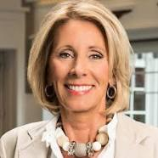
“Education is the civil rights
issue of our time”
Education Sec. Betsy DeVos
Undersecretary – vacant
Assistant Secretary of Postsecondary Education - vacant
Domestic Policy Council
Limit federal role in education
Nix red tape/regulations
Trump budget cuts
Notes:
Like former presidents George W. Bush and Barack Obama before him, Donald Trump has said, “Education is the civil rights issue of our time.”
On the campaign trail he said little about higher education despite being asked more often about student debt than any other issue except national defense. The one thing we know with some degree of certainty is that the Trump Administration will seek to curtail the federal government’s role in education. He’s already proposed a $20-B program that would allow federal funding to follow students to the K-12 school of their choice, including private schools. Also, he proposed a modification to income-based repayment which we will cover momentarily.
The President selected Betsy DeVos – a champion of school vouchers for private and charter schools to lead the U.S. Department of Education. She was confirmed on Feb. 7 to lead the smallest Cabinet agency with approximately 4,500 FTE and the 3rd largest discretionary appropriation. Although her background on higher education is negligible, that is not particularly unusual as typically Secretaries rely heavily on a team assembled to focus on all matters concerning postsecondary education. These two key positions are the Undersecretary and the Assistant Secretary of Postsecondary Education. Both of these are still vacant and it is hoped that the Trump Administration would fill them quickly. These two in combination with President Trump’s Domestic Policy Council, will push the President’s higher education agenda in the 115th Congress.

Slide 16
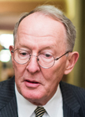
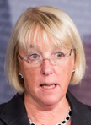
Senate Health Ed Labor & Pensions
HEA Focus
  FAFSA simplification
  One Loan & One Grant
  Reduce Loan Limits
  10-year standard & one IDR plan
  Institutional Accountability
  Dems focus on refinancing
  Dems focus on lower interest rates
  Dems debt free tuition (focus on CC)
Lamar Alexander (TN)
Chairman
Patty Murray (WA)
Ranking Member
Notes:
Alexander: 1) simplify the FAFSA from 103 to 2 questions. 2) Discontinue Direct Loans and Perkins and replace with a single loan program with parallel terms and conditions to Direct Unsubsidized Loans. No subsidy Student loans would be limited to COA minus grants and scholarships. Student loans would be included in estimated financial assistance. Schools could reduce the amount of a student loan, or refuse to certify it altogether, under exceptional circumstances. Schools would still be responsible for determining the amount of the loan and setting disbursement schedules as currently defined. The annual loan limit would be $8,000 for undergraduates and $30,000 for graduate or professional students. Institution allowed higher graduate/professional annual limits for students in programs with high need up to a 50% increase in their aggregate limitations. The undergraduate aggregate limit would be $37,500; the graduate/professional aggregate limit would be $150,000 (not including any undergraduate loans). Repayment would begin after a 6-month grace period. ED would be required to provide information about the two repayment options available to the borrower: the income-based repayment plan and a 10-year plan with fixed monthly payments.
Democrats: “free” community college and “debt free tuition” at public four-year institutions. Lower interest rates; refinancing; institutional risk sharing; an expansion of tax credits; additional consumer protections; increased transparency for all colleges; and further regulation of the proprietary sector.
Rs (12): Lamar Alexander, TN – Chairman; Mike Enzi, WY; Richard Burr, NC; Johnny Isakson, GA; Rand Paul, KY; Susan Collins, ME; Bill Cassidy, LA; Todd Young, IN; Orrin Hatch, UT; Pat Roberts, KS; Lisa Murkowski, AK; Tim Scott, SC
Ds (11): Patty Murray, WA - Ranking Member; Bernie Sanders, VT (I); Bob Casey, PA; Al Franken, MN; Michael Bennet, CO; Sheldon Whitehouse, RI; Tammy Baldwin, WI; Chris Murphy, CT; Elizabeth Warren, MA; Tim Kaine, VA; Maggie Hassan, NH

Slide 17




House Ed & Workforce
HEA focus will include:
  College costs & affordability
  Simplify & Improve Aid and
  Repayment Options
  Accountability & Transparency
  Improve Financial Literacy
  FAFSA simplification
  Reduce Red Tape / Regs
Brett Guthrie (KY)
Chairman, Subc. Higher Education & Workforce Development
Virginia Foxx (NC)
Chairman
Susan Davis (CA)
Ranking Member Higher Education & Workforce Development
Bobby Scott (VA)
Ranking Member
Notes:
Students must navigate 6 different types of federal loans, 9 types repayment plans, 8 forgiveness programs, and 32 deferment or forbearance options, each with its own rules and regulations.
Financial literacy: “Empowering Students to Enhance Financial Counseling Act” would improve the timing, frequency, and content of financial aid counseling. The changes to current policy would help students better understand their options and responsibilities when it comes to paying for college.
Rs (23): Virginia Foxx, NC – Chairwoman; Joe Wilson, SC - Vice Chairman; Duncan Hunter, CA; Phil Roe, TN; Glenn Thompson, PA; Tim Walberg, MI; Brett Guthrie, KY; Todd Rokita, IN; Lou Barletta, PA; Luke Messer, IN; Bradley Byrne, AL; Dave Brat, VA; Glenn Grothman, WI; Steve Russell, OK; Elise Stefanik, NY; Rick Allen, GA; Jason Lewis, MN; Francis Rooney, FL; Paul Mitchell, MI; Tom Garrett, VA; Lloyd Smucker, PA; Drew Ferguson, GA; Vacancy
Ds (17): Bobby Scott, VA - Ranking Member; Susan Davis, CA; Raúl Grijalva, AZ; Joe Courtney, CT; Marcia Fudge, OH; Jared Polis, CO; Gregorio Kilili Camacho Sablan, N. Marianas; Frederica Wilson, FL; Suzanne Bonamici, OR - Vice Ranking Member; Mark Takano, CA; Alma Adams, NC; Mark DeSaulnier, CA; Donald Norcross, NJ; Lisa Blunt Rochester, DE; Raja Krishnamoorthi, IL; Carol Shea-Porter, NH; Adriano Espaillat, NY
Subc. on Higher Education and Workforce Development
Rs (12): Brett Guthrie, KY – Chairman; Glenn Thompson, PA; Lou Barletta, PA; Luke Messer, IN; Bradley Byrne, AL; Glenn Grothman, WI; Elise Stefanik, NY; Rick Allen, GA; Jason Lewis, MN; Paul Mitchell, MI; Tom Garrett, VA; Lloyd Smucker, PA
Ds (10): Susan Davis, CA - Ranking Member; Joe Courtney, CT; Alma Adams, NC; Mark DeSaulnier, CA; Raja Krishnamoorthi, IL; Jared Polis, CO; Gregorio Kilili Camacho Sablan, N. Marianas; Mark Takano, CA; Lisa Blunt Rochester, DE; Adriano Espaillat, NY

Slide 18
DVM Call to Action
Advocate & join AVMA Congressional Advocacy Network www.AVMACAN.AVMA.org
Visit Senate/Rep. district offices & State lawmakers offices
Call U.S. Senators/Representative & State lawmakers
Attend a Town Hall for your member of Congress
Stay informed -- read the AVMA Advocate, AVMA At-Work, Facebook, AVMA and AAVMC Twitter
Advocacy Day Events (AVMA/SAVMA Fly In, State VMAs)
Advocacy Externships & Fellowships (AVMA GRD)
Volunteer/get involved/contribute to a campaign/PACs
Notes:
AVMA and AAVMC are committed to addressing the needs of aspiring and early career veterinarians and are working with stakeholder partners to reduce the debt-to-income ratio from 2.1:1 to 1.4:1. To achieve this goal we are co-leading the multifaceted Fix the Debt initiative. Among our goals is lead a successful national advocacy campaign advancing our priorities that will improve to student financial aid. We invite veterinary students, early career veterinarians and others to join AVMA’s Congressional Advocacy Network. Together we will urge lawmakers to take steps that alleviate the debt burden felt by veterinarians by passing bills to make the federal student aid system better serve the needs of all veterinary students. Get involved locally, in your state and nationally.
Student members can now contribute to the AVMAPAC - AVMA members may contribute to the AVMA Political Action Committee which provides opportunities to support and elect candidates who understand veterinary medicine and support our legislative agenda. The AVMA PAC manager is Natalie Thomas (202.289.3206, natalie@ntdcinc.com).

Slide 19
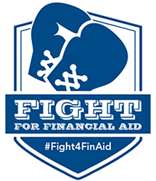



Tools You Can Use

Slide 20
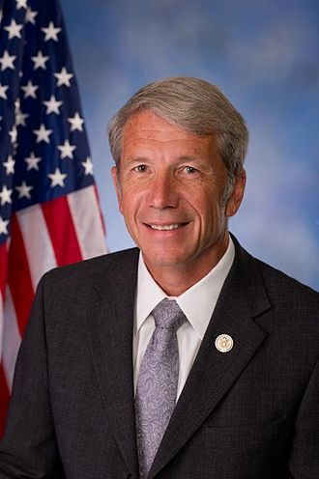
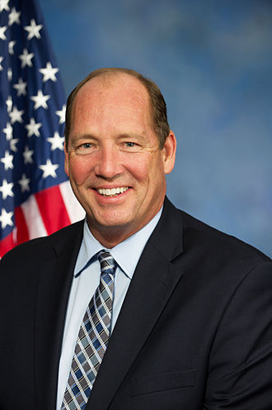
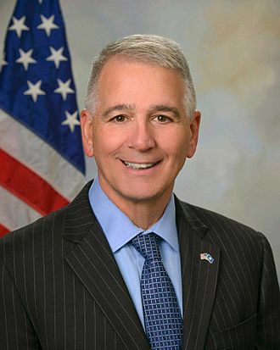
Congressional Veterinary Medicine Caucus
Educates members and staff on importance of veterinary medicine to research, public health, animal health, welfare, food safety, U.S. economy, etc.
Kurt Schrader, DVM (OR)
Co-Chair
Ted Yoho, DVM (FL)
Co-Chair
Ralph Abraham,
DVM, MD, (LA)
Notes:
It is important that folks in the health professions run for office – public policy has a direct impact on the health professions. There are 28 health professionals serving in the 115th Congress -- 3 physicians and 1 optometrist in the Senate. In the House there are 11 physicians, 4 dentists and 3 veterinarians; 3 psychologists, 1 pharmacist, and 2 nurses.
Reps. Schrader and Yoho established the bi-partisan CVMC to provide a forum to educate elected members and their staff on the importance of veterinary medicine to research, public health, animal health and welfare, food safety, and our overall economy. The caucus also keeps members informed about the opportunities and challenges facing veterinary medicine. There are 35 members currently:
Co-chair - Kurt Schrader, DVM (OR-05) and Co-chair - Ted Yoho, DVM (FL-03)
Ralph Abraham, DVM (LA-05); Lois Capps (CA-24); Jim Costa (CA-16); Joe Courtney (CT-02); Rodney Davis (IL-13); Susan Davis (CA-53); Peter DeFazio (OR-04); Suzanne DelBene (WA-01); John Duncan (TN-02); Bill Flores (TX-17); John Garamendi (CA-03); Morgan Griffith (VA-09); Gregg Harper (MS-03); Vicky Hartzler (MO-04); Alcee Hastings (FL-20); Jody Hice (GA-10); Ann Kuster (NH-03); David Jolly (FL-13); David Joyce (OH-14); Shelia Jackson Lee (TX-18); Dan Lipinski (IL-03);
Betty McCollum (MN-04); Jim McGovern (MA-02); Donald Norcross (NJ-01); Mark Pocan (WI-02);
Jared Polis (CO-02); David Price (NC-04); Mike Rogers (AL-03); Peter Roskam (IL-06); Kyrsten Sinema (AZ-09); GT Thompson (PA-05); Jackie Walorski (IN-02); Kevin Yoder (KS-03)

Slide 21
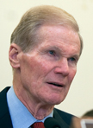
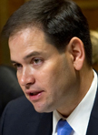
Florida Senators
Bill Nelson, D-FL
202.224.5274
716 Hart
Finance; Armed Services; Aging;
Commerce, Science, Transportation;
Marco Rubio, R-FL
202.224.3041
284 Russell
Appropriations; Small Business; Foreign Relations; Intelligence; Aging

Slide 22
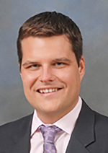
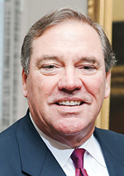


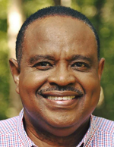
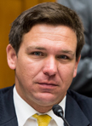
Florida Representatives
Matt Gaetz R-1st
202.225.4136, 507 Cannon
Armed Services; Budget; Judiciary
Neal Dunn R-2nd
202.225.5235, 423 Cannon
Science, Space & Technology; Veterans Affairs
Ted Yoho R-3rd
202.225.5744, 511 Cannon
Agriculture; Foreign Affairs
John Rutherford R-4th
202.225.2501, 230 Cannon
Homeland Security;
Veterans Affairs
Al Lawson D-5th
202.225.0123, 1337 Longworth
Agriculture; Small Business
Ron DeSantis R-6th
202.225.2706, 1524 Longworth
Foreign Affairs; Judiciary;
Oversight & Government Reform

Slide 23
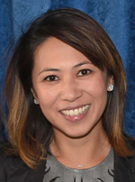
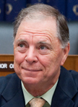
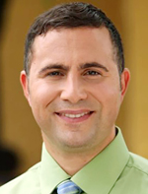

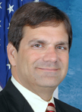
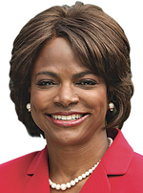
Florida Representatives
Stephanie Murphy D-7th
202.225.4035, 1237 Longworth
Armed Services; Small Business
Bill Posey R-8th
202.225.3671, 2150 Rayburn
Financial Services;
Science, Space & Technology
Darren Soto D-9th
202.225.9889, 1429 Longworth
Agriculture; Natural Resources
Val Demings D-10th
202.225.2176, 238 Cannon
Homeland Security;
Oversight & Government Reform
Daniel Webster R-11th
202.225.1002, 1210 Longworth
Natural Resources;
Science, Space & Technology
Gus Bilirakis R-12th
202.225.5755, 2112 Rayburn
Energy & Commerce; Veterans Affairs

Slide 24


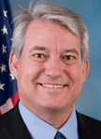


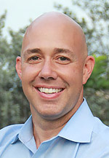
Florida Representatives
Charlie Crist D-13th
202.225.5961, 427 Cannon
Financial Services;
Science, Space & Technology
Kathy Castor D-14th
202.225.3376, 2052 Rayburn
Energy & Commerce
Dennis Ross R-15th
202.225.1252, 436 Cannon
Financial Services;
Oversight & Government Reform
Vern Buchanan R-16th
202.225.5015, 2104 Rayburn
Ways & Means
Tom Rooney R-17th
202.225.5792, 2160 Rayburn
Appropriations; Select Intelligence
Brian Mast R-18th
202.225.3026, 2182 Rayburn
Foreign Affairs;
Transportation & Infrastructure

Slide 25

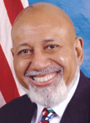
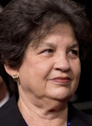
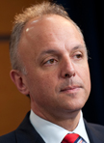

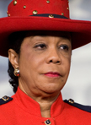
Florida Representatives
Francis Rooney R-19th
202.225.2536, 120 Cannon
Education & the Workforce;
Foreign Affairs; Joint Economic
Alcee Hastings D-20th
202.225.1313, 2353 Rayburn
Rules
Lois Frankel D-21st
202.225.9890, 1037 Longworth
Foreign Affairs;
Transportation & Infrastructure
Ted Deutch D-22nd
202.225.3001, 2447 Rayburn
Ethics; Foreign Affairs; Judiciary
Debbie Wasserman Schultz D-23rd
202.225.7931, 1114 Longworth
Appropriations; Budget
Frederica Wilson D-24th
202.225.4506, 2445 Rayburn
Education & the Workforce;
Transportation & Infrastructure

Slide 26

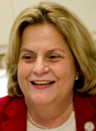

Florida Representatives
Mario Diaz-Balart R-25th
202.225.4211, 440 Cannon
Appropriations; Budget
Ilena Ros-Lehtinen R-27th
202.225.3931, 2206 Rayburn
Foreign Affairs;
Select Intelligence
Carolos Curbelo R-26th
202.225.2778, 1404 Longworth
Ways & Means

